Slide 1
Vehicle Detection and Counting System using OpenCV
Project Member 1 – Sarthak Kurothe [211420]
Project Member 2 – Satvika Singh [211441]
Submitted to – Dr. Sahil Sharma
Assistant Professor, Dept. of CS&IT, JUIT, Waknaghat

Slide 2
AGENDA
Introduction
Problem Statement
Aims and Objectives
Technology Stack
Significance of the Project
Project Features
Practical Demo
GitHub Link to Project Page

Slide 3
INTRODUCTION
In this project, we will be coding a vehicle counting and detection system. It will be enough to work for both the images or the video, for the same, we will be using OpenCV for doing all the image processing operations and for classification the car and bus HAAR cascade classifier for detecting and counting the cars and buses.
OpenCV-analysis and understanding of images and videos taken by an advanced camera-has acquired more approval and been utilized in numerous fields including industry, medication, robotics, and so on. Computer vision has likewise been applied for addressing traffic and transportation problems.

Slide 4
PROBLEM STATEMENT
The trouble of getting the initial background there is the mistake of continuous background update and the trouble of controlling the update speed in moving vehicle location of traffic video.
And with the expanding number of streets and traffic everywhere on the world, traffic observing and control utilizing current advancements has become a convincing necessity.
The Vehicle detection is the key task in this area and counting of a vehicle plays a important role and this two are important applications.

Slide 5
AIMS AND OBJECTIVE
The main objective of this project is to detect, count different types of vehicles. This project aims to address an accurate and beneficial in moving vehicle recognition and counting technique that can be utilized in the perplexing traffic environment.
The methods like adaptive background subtraction, binarization, and morphological activities are used to detect a moving vehicle, obtain a foreground area and eliminate noise and shadow in a video.
This may directly help in two kind of peoples : Street users and traffic organizations. In the event that street users know the constant traffic data, they can utilize the data to pick the most ideal path for traveling and can keep away from congestion.

Slide 6
TECHNOLOGY STACK

Slide 7
SIGNIFICANCE OF THE PROJECT
Helps traffic police: A vehicle detection and counting system could be beneficial for the traffic police because everything they can monitor from one place like how many vehicles have crossed this toll and which vehicle.
Maintaining records: It is challenging for some individuals to record all the vehicles with them because the cars are passing by in real-time. It’s not like that one is watching the video, and they can pause it and have a note of it, so to remove this limitation, this application can be very well-versed to attain the time-saving quality and be automated.
Traffic surveillance control: As this application can be planted anywhere as it only requires a camera or some wires (for establishing the connectivity with the central system) hence if the traffic is high at someplace, then from that area, an officer can monitor it and forward the information to next toll officer so that they could be prepared beforehand.

Slide 8
PROJECT FEATURES
Pseudo code of a proposed method:
Step1: Foreground Extraction
Step2: Region of Interest
Step3: Detection of a Vehicle
Step4: Counting of a Vehicle
Step1: Foreground Extraction : The background subtraction method is utilized to initially identify pixels that would have a place with a moving vehicle. Specifically, a background image of the street contains no vehicle, and the present frame in the video is changed over from color (RGB) to gray-scale image. At that point, for every pixel (x, y), the gray intensity of a background image is deducted by that of a current frame.

Slide 9
Step2: Region of Interest (ROI) : A ROI, which will further processed. The ROI is isolated into zones. Each will be handled contrastingly in the following steps. Also, a further zone, called virtual detection zone, is predefined for counting a vehicle. The virtual recognition zone is situated inside zones which is the centerpiece of ROI.
Step3: Detection of a Vehicle : In this step, just pixels in the ROI are thought of while the others are erased. The thresholding function is applied to the distinction image to set apart foreground pixels from background pixels dependent on their intensity. On the off chance that the pixel intensity in an image difference is more than the predefined threshold value, it will be set to 255 (white); else, it will be set to 0 (dark). It is observed that the foreground objects set off smoother, more clear and more proper for recognition and counting measure.

Slide 10
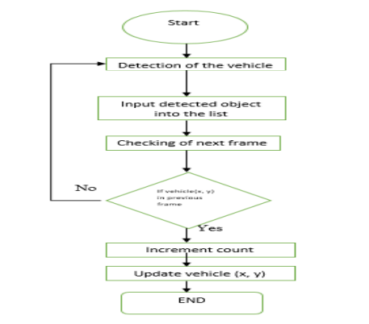
Step4: Counting of a Vehicle : After vehicle contours are gotten, the virtual detection zone is utilized to count the number of a vehicles. The centroid of each forefront object is determined and tracked. At the point when the centroid of a vehicle is recognized the first time. The status is set to 0 (it's not yet counted). At that point, its position is tracked. On the off chance that it arrives at the virtual recognition, its status will be set to 1 (counted), showing that it has been counted and won't be counted in the resulting frames.

Slide 11
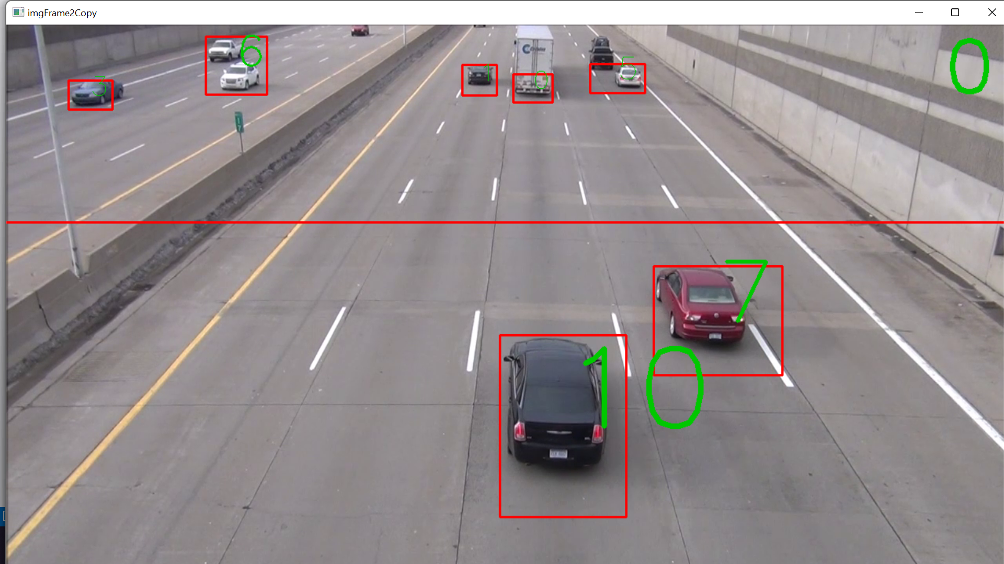
PRACTICAL DEMO

Slide 12
GITHUB LINK TO PROJECT PAGE
https://github.com/sarthak2489/Detection-and-Counting-Vehicles-using-OpenCV.git

